Slide 1
2023-02-08

Slide 2
Unit 8 Project

Slide 3
This week and next
Wed 2/8: Unit 8 Project
Fri 2/10: Unit 8 Project
Mon 2/13: Unit 8 Review + more time on Unit 8 Project
Wed 2/15: Unit 8 Test. Unit 8 Project DUE Wed morning
Fri 2/17: NO CLASS
Mon 2/20: NO CLASS

Slide 4
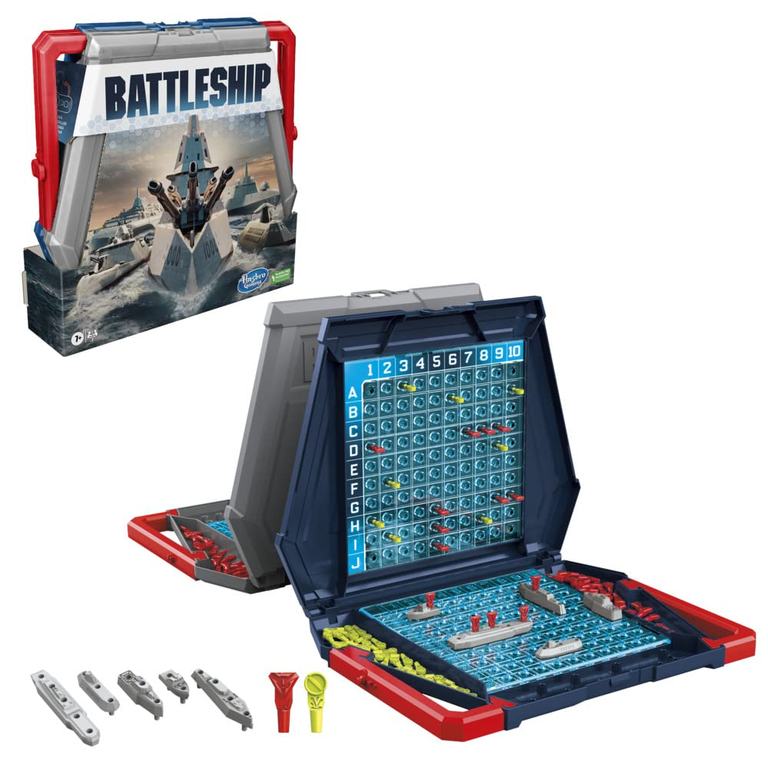

Slide 5
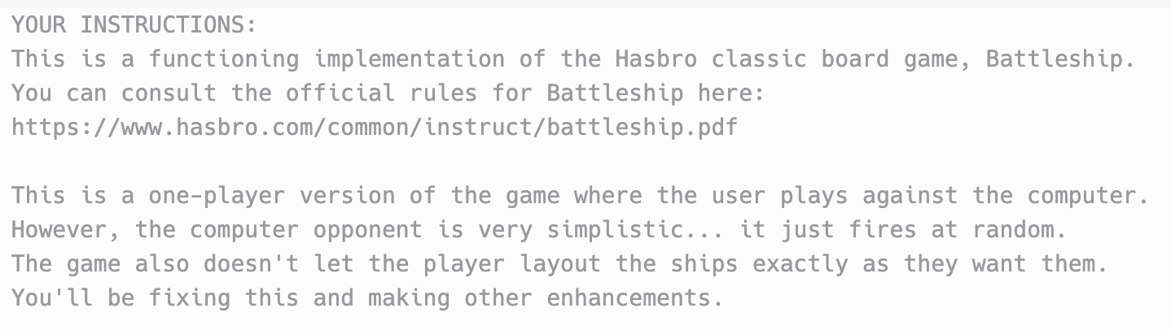

Slide 6
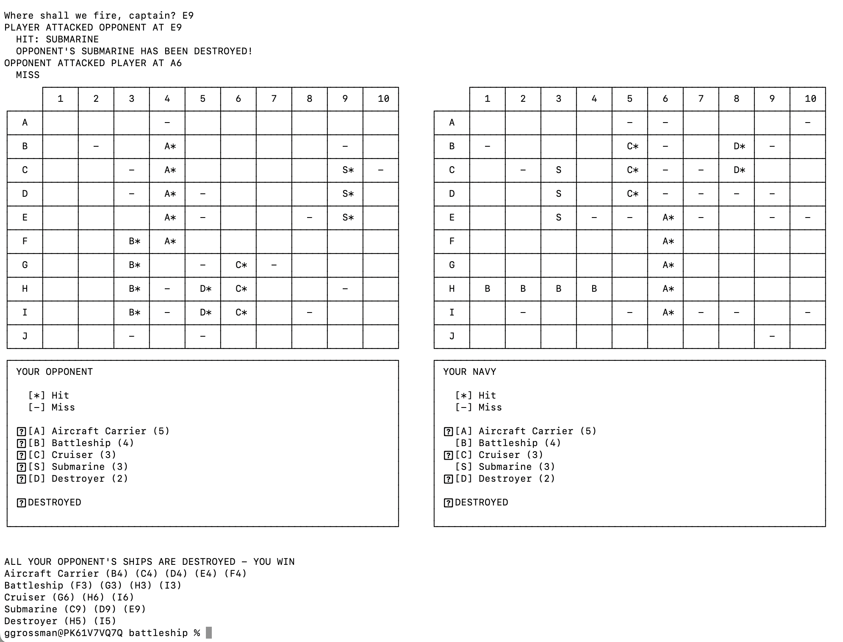

Slide 7
Game
player
opponent
Player
Player
playerGrid
opponentGrid
playerGrid
opponentGrid
Grid
Grid
Grid
Grid
Cell | Cell | Cell
Cell | Cell | Cell
Cell | Cell | Cell
Cell | Cell | Cell
Cell | Cell | Cell
Cell | Cell | Cell
Cell | Cell | Cell
Cell | Cell | Cell
Navy
Navy

Slide 8
1. The game exits after you win or lose. Change it so the game asks whether you'd like to play again. If the player says yes, the game should restart from a blank state. (If you're writing a lot of code to reset the game, consider other options... this should only take a few lines!) (10 points)
2. Add a cheater "peek" command that lets you see the positions of your opponent's ships. (10 points)
3. Make it so pressing Return instead of entering a valid move makes a random move. (10 points)
4. The player's ships are laid out randomly right now. Ask the user when the game starts whether they want random or manual layout. If they choose manual layout, ask them for the starting position and whether to lay out horizontal/vertical for each ship in the navy. Print an error and ask again if they choose an impossible position (goes off edge of grid or conflicts with another ship.) (30 points)

Slide 9
5. Implement the "AI" for choosing the computer's next move by implementing the selectTarget() method of class Player. This does not have to be perfect, but it should do a better job than firing randomly.
At a minimum, if the computer has scored a hit and the ship isn't sunk yet, the computer should fire on a not-yet-fired-upon location adjacent to such a hit. Full points will be given for that. See the two pseudocode examples at the bottom of these instructions.
A sophisticated implementation will be able to see that a series of hits are horizontal or vertical, and know to fire upon the next adjacent horizontal or vertical space.
(30 points)
6. The AI for choosing the computer's move should be able to function as a hint mode for the player too. Add a "suggest" command which uses the AI to suggest a next move for the player. (10 points)

Slide 10

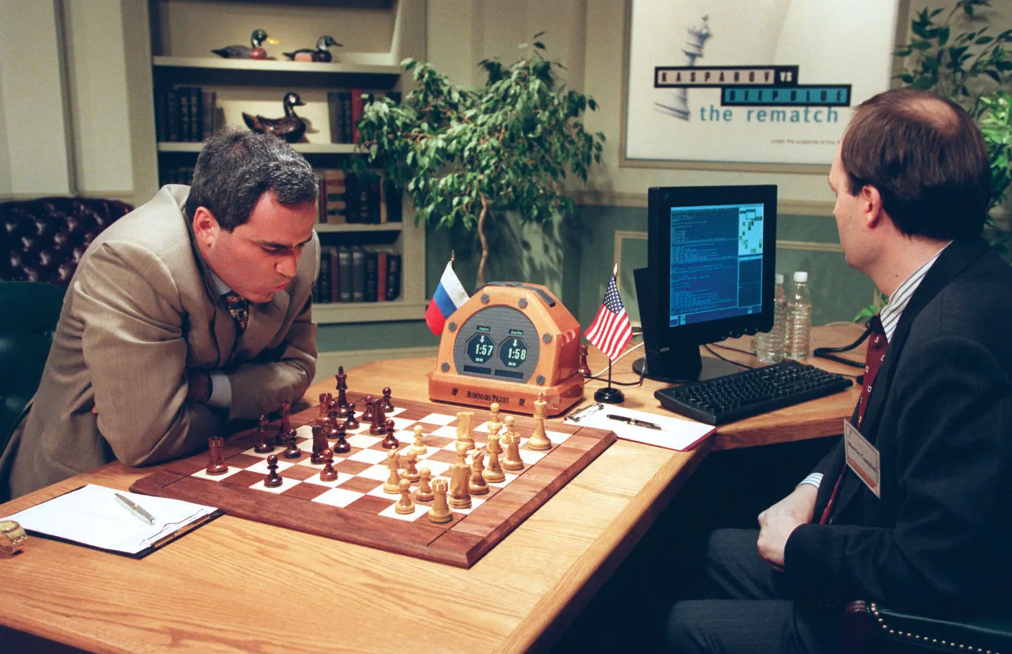
Deep Blue vs. Garry Kasparov Feb 10, 1996 – May 11, 1997

Slide 11
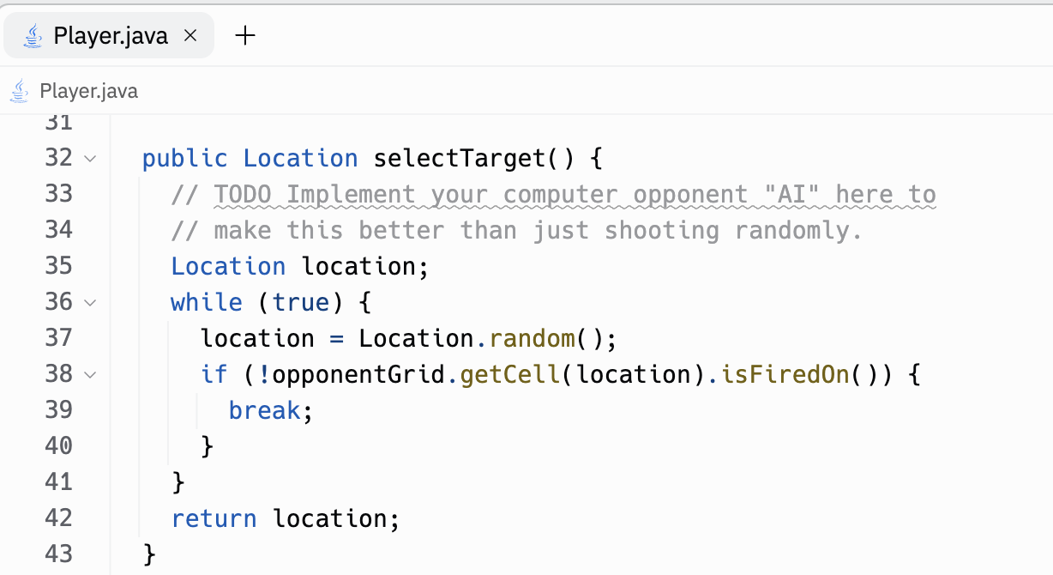

Slide 12
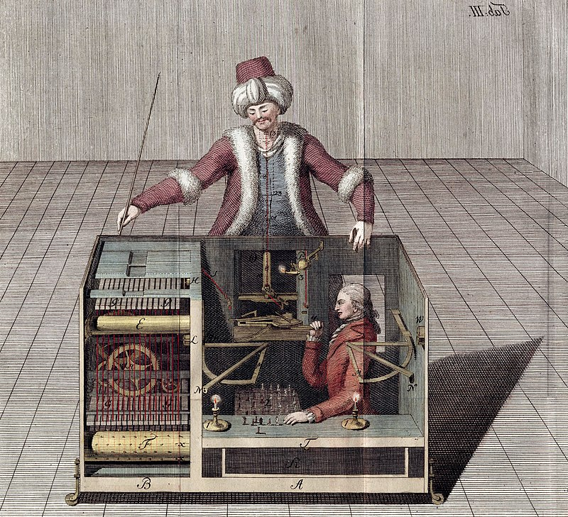
Note: Your AI should NOT cheat... even though your code can access the location of the player's ships, the AI should play like a player that can't see the exact locations and has to figure out where the ship is by trial and error.

Slide 13
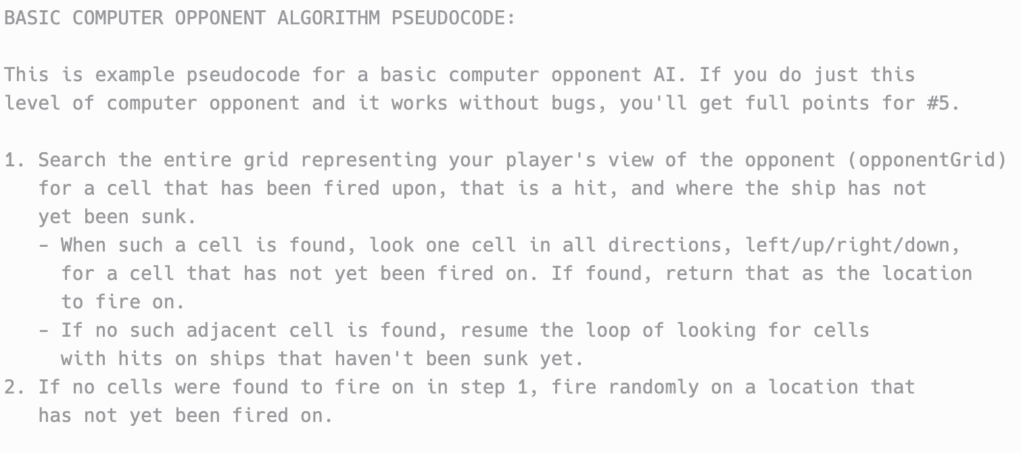

Slide 14
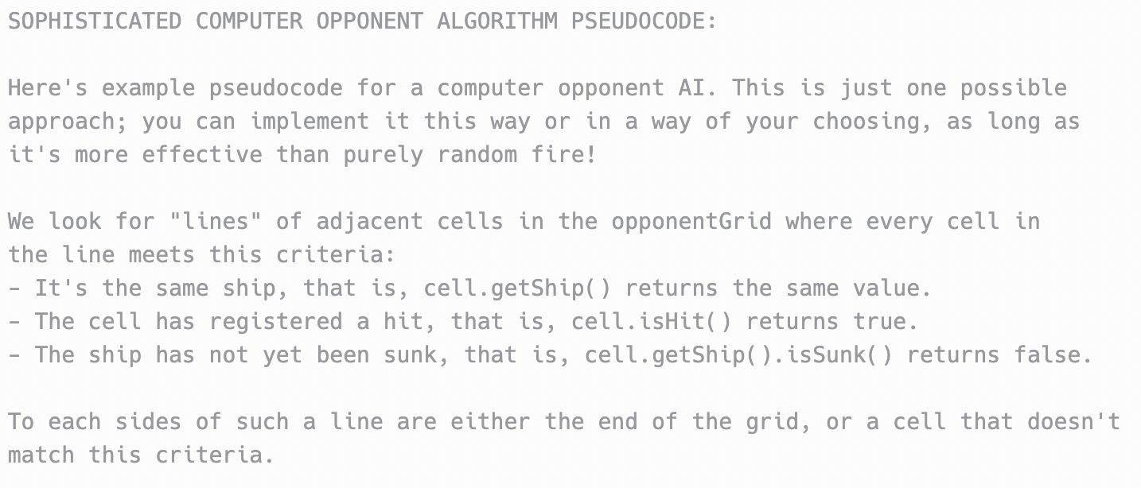

Slide 15
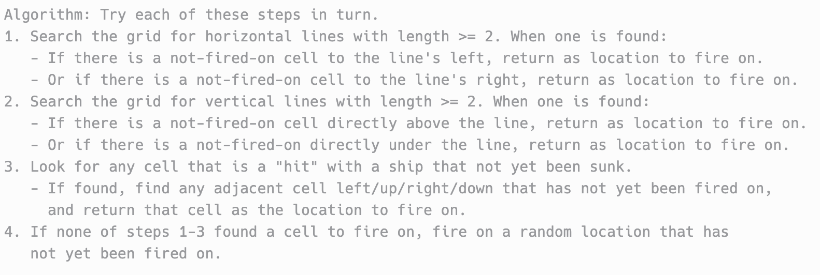

Slide 16
Hints from Chris
#2: Using Player.getDamageReport() is not going to get you want you need; It does not display ship positions
#4: For folks writing ship placement code - If you want to save some time check out Ship.placeShip() and Grid.isLegal()
#5-6: Your AI - Player.selectTarget() - SHOULD NOT be accessing Cell.getShip() - restrict your usage to Cell.isFiredOn(), Cell.isHit(), and Cell.isMiss()
UPDATE from Gary: It is OK to call Cell.getShip(), since you are told when you get a hit which ship it is, e.g. Tom: "D-4." Frank: "Hit. Destroyer." But don't look at the locations array in Ship because that would be cheating! The AI can know which ship was hit, but not where it is other than where it's already landed hits.

